Slide 1

Overview and Fundamentals of Medical Image Segmentation
201921071 김나현

Slide 2
1. Introduction
Goal : partition an image into regions that are homogeneous with respect to one or more characteristics or features
Various application in medicine
No one standard segmentation technique
Definition of goal of segmentation varies
Different assumptions, different algorithms

Slide 3
1. Introduction
Segmentation techniques depending on classification scheme
manual, semiautomatic, and automatic
Pixel-based and region-based,. Etc
Two broad categories : (1) region segmentation (2) edge-based segmentation

Slide 4
1. Introduction
Region segmentation
Thresholding
Common
Group according to value of pixels based on selected threshold
Global, local
Clustering Algorithms
Partition the image into sets or clusters of pixels that have strong similarity
Region growing
- Assign adjacent pixels or regions to the same segment

Slide 5
1. Introduction
(2) Edge-based segmentation
Find object boundaries and segment regions enclosed by the boundaries
Gradient operators, graph searching, contour following
One type of image, improve
By combining image from several sources (Multi-spectral segmentation)
Integrating images over time (dynamic or temporal segmentation)

Slide 6
2. Thresholding
Image histogram / local properties
Global thresholding
Only one threshold selected for the entire image
Local thresholding
- Depends on local properties of image regions
- Dynamic, adaptive : selected independently for each pixel

Slide 7

2.1. Global Thresholding
Bimodal histogram, compares image values with a threshold value T
Select a threshold T
Intensive value
1 -> objects 0 -> background

Slide 8
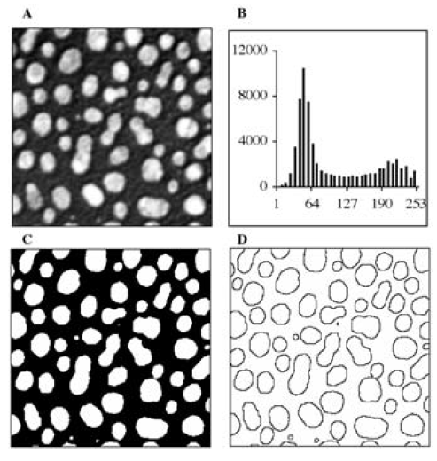
2.1. Global Thresholding
2A – original image
0~255 pixel intensities
2B – histogram : T = 127
(minimum between two modes)
2C – higher than T(127) : white
2D – outlines of the cells : 3x3 Laplacian

Slide 9
2.1. Global Thresholding
Minimize the probability of error
Semiautomated (MR image) : two pixel, compare distribution of pixel intensity, automatically calculate, manually modify border
Extract lymph nodes from CT image

Slide 10
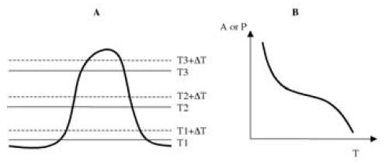
2.1. Global Thresholding
Appropriate segmentation - Minimally sensitive to small variation
Sensitivity of threshold level section
3A – intensity profile of object :
three threshold levels
Small variation ΔT
significant change : Lowest and highest
Minimal effect : Middle

Slide 11
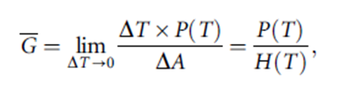
2.1. Global Thresholding
3B - Area A(T), Perimeter P(T)
Minimizes either dA(T)/dT or dP(T)/dT
Multiple thresholds : gradient magnitude
Average gradient magnitude
Select maximize average boundary gradient

Slide 12
2.1. Global Thresholding
More than two types of regions
Individual thresholds
Multithresholding technique
Histogram modes more difficult to distinguish, threshold section more difficult
Pros and Cons
Computationally simple and fast
Works well with uniform intensity values on a contrasting background
fail : low contrast(object-background), noisy,
background intensity varies significantly across the image

